Slide 1
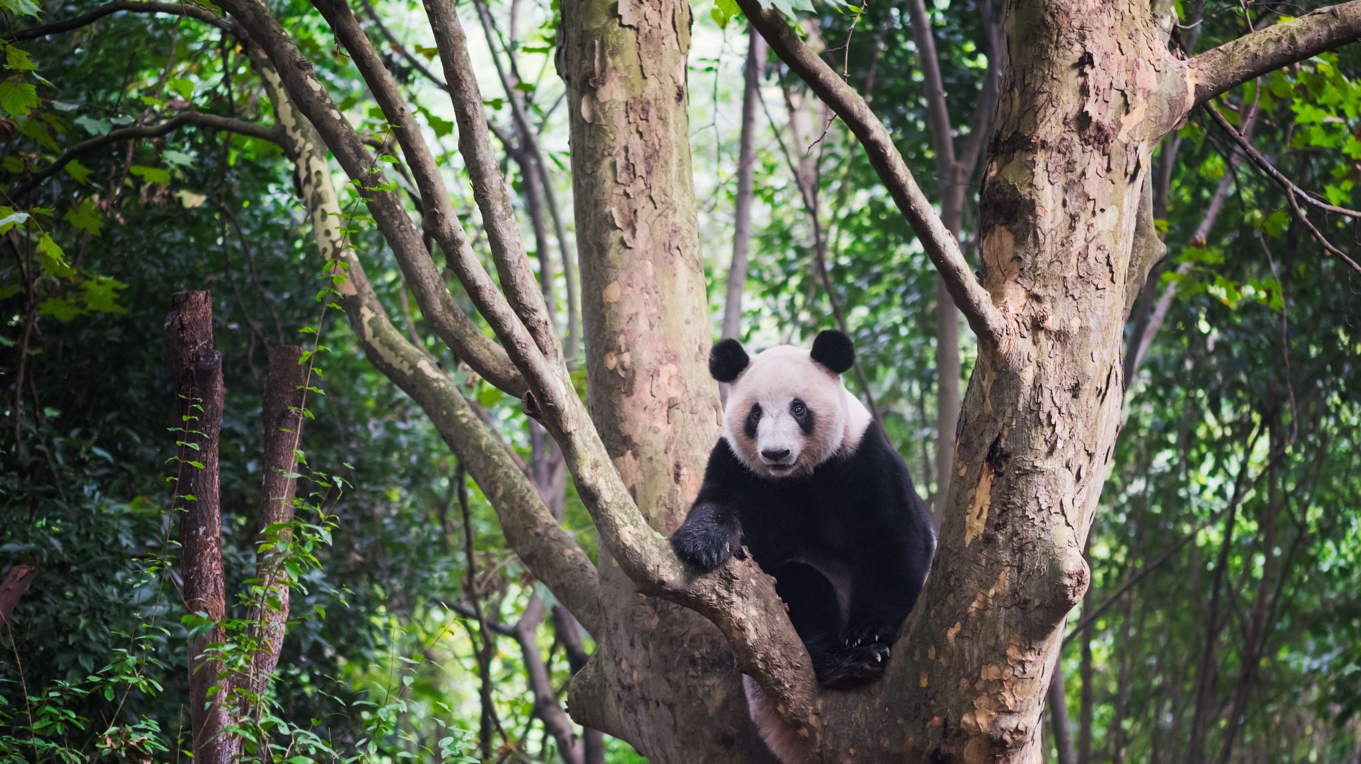
Python Data Process Advanced Topics – ½ pandas and visualization
Minquan

Slide 2
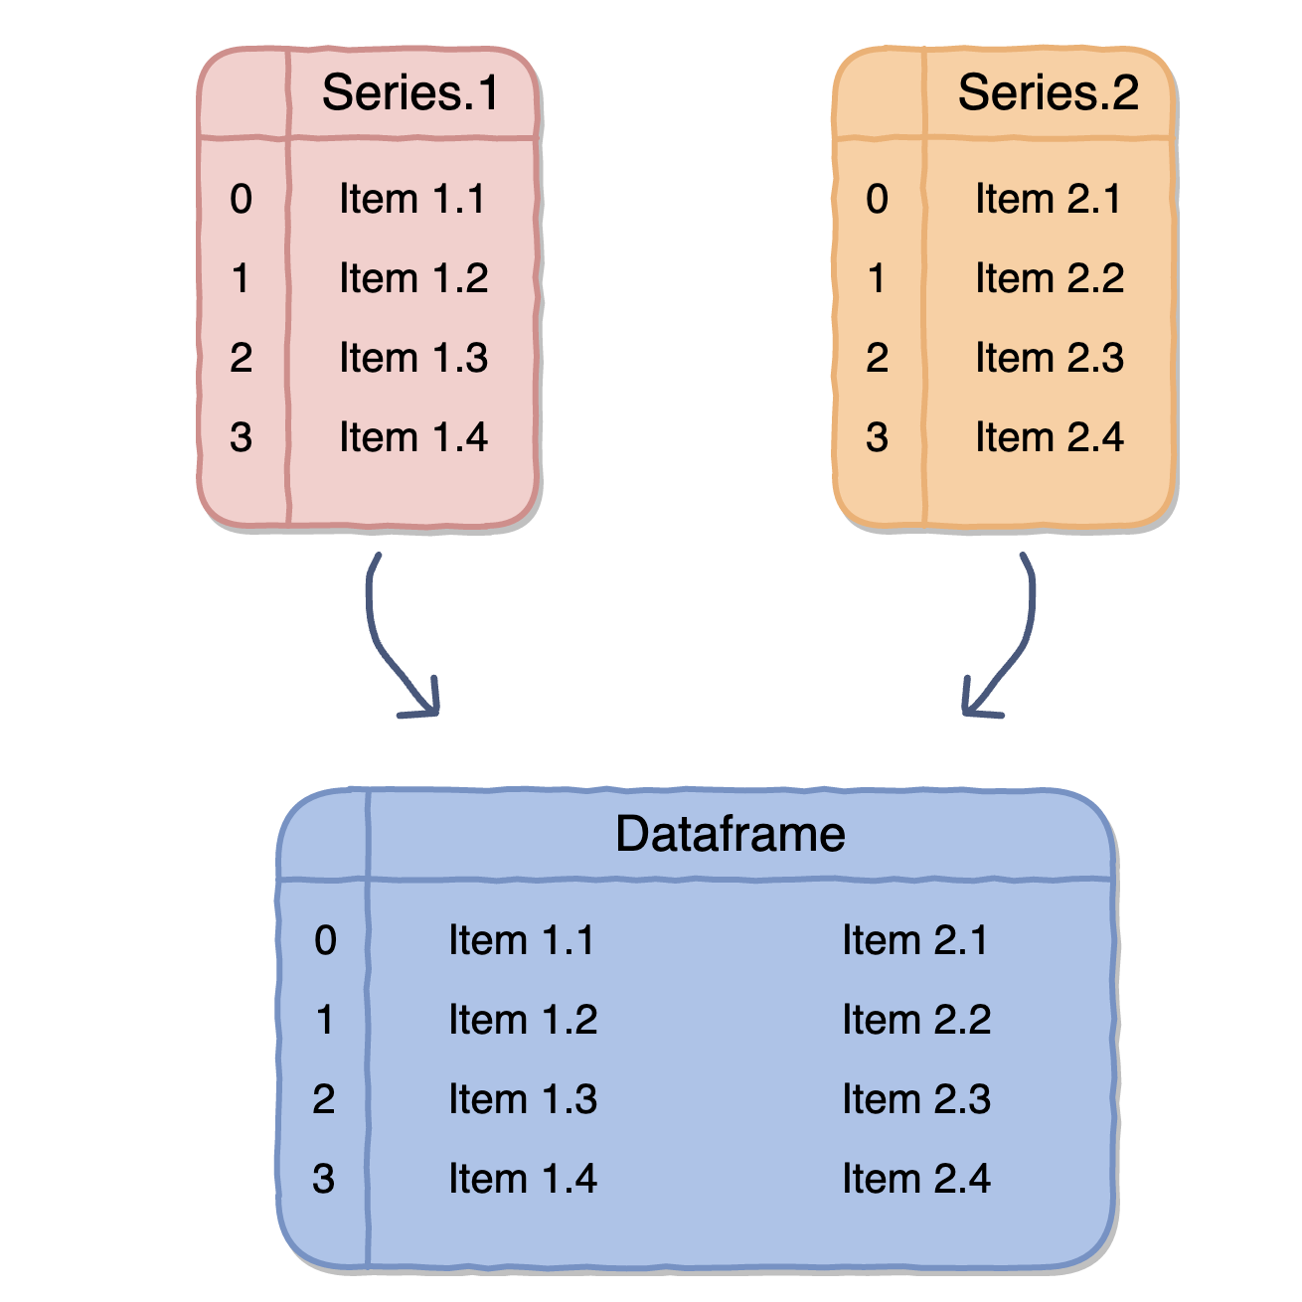
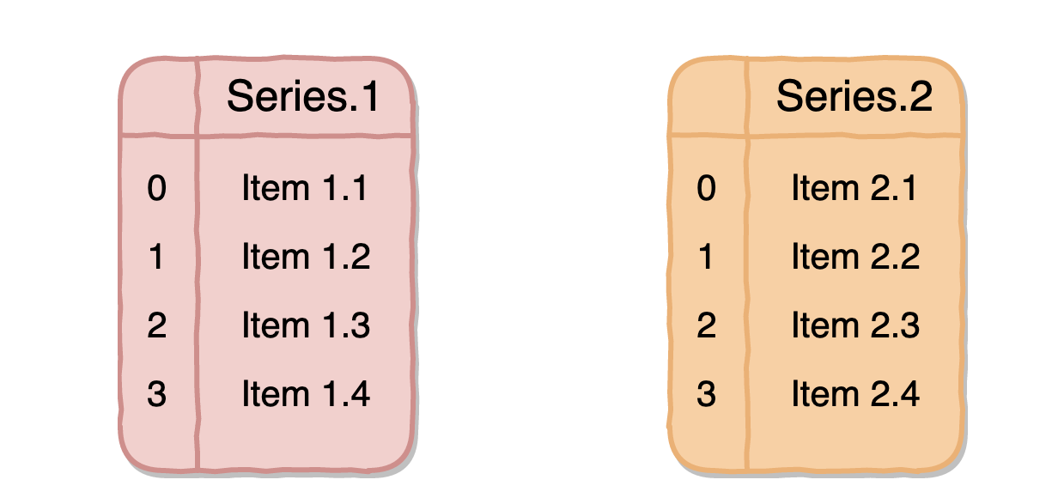
Series vs dataframe
>>> fruits = pd.DataFrame(all_fruits)
>>> fruits = pd.Series(["apples", "oranges", "bananas"])

Slide 3
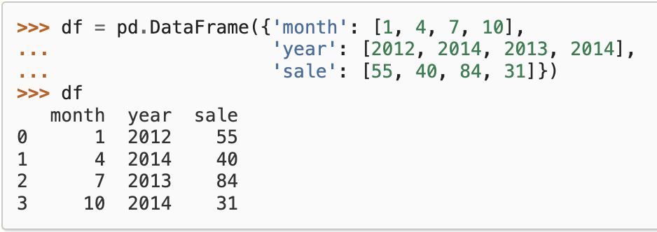
Pandas - INDEX
>>> df.iloc[0]

Slide 4
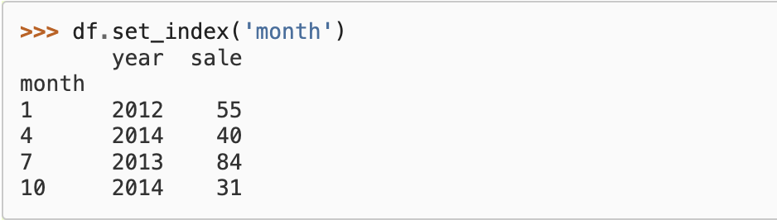
>>> df.loc[10]
>>> df[10]
>>> df.ix[10]

Slide 5
Pandas
Mapping, Grouping, Aggregation, Transform
Join, Concat, Merge

Slide 6
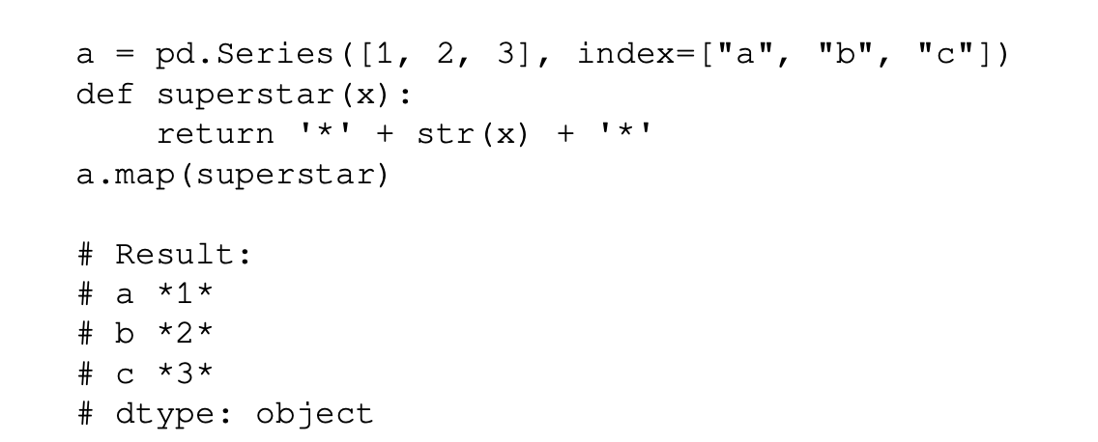
Pandas mapping

Slide 7
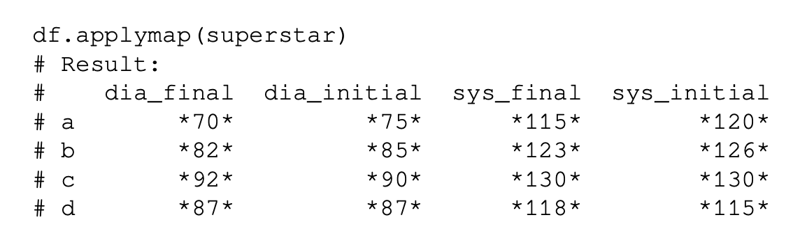
Pandas mapping

Slide 8
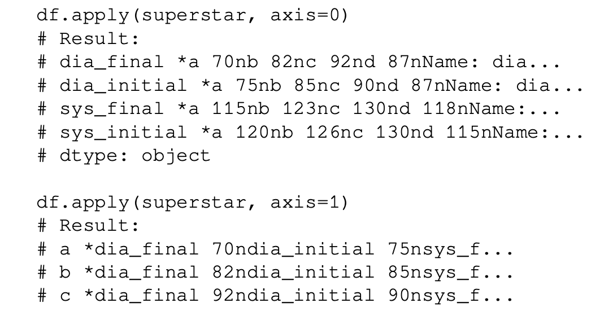
Pandas mapping / apply

Slide 9
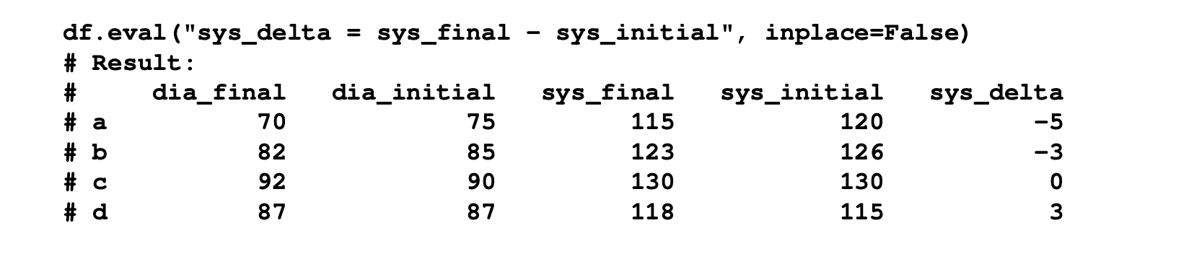
Df.eval

Slide 10
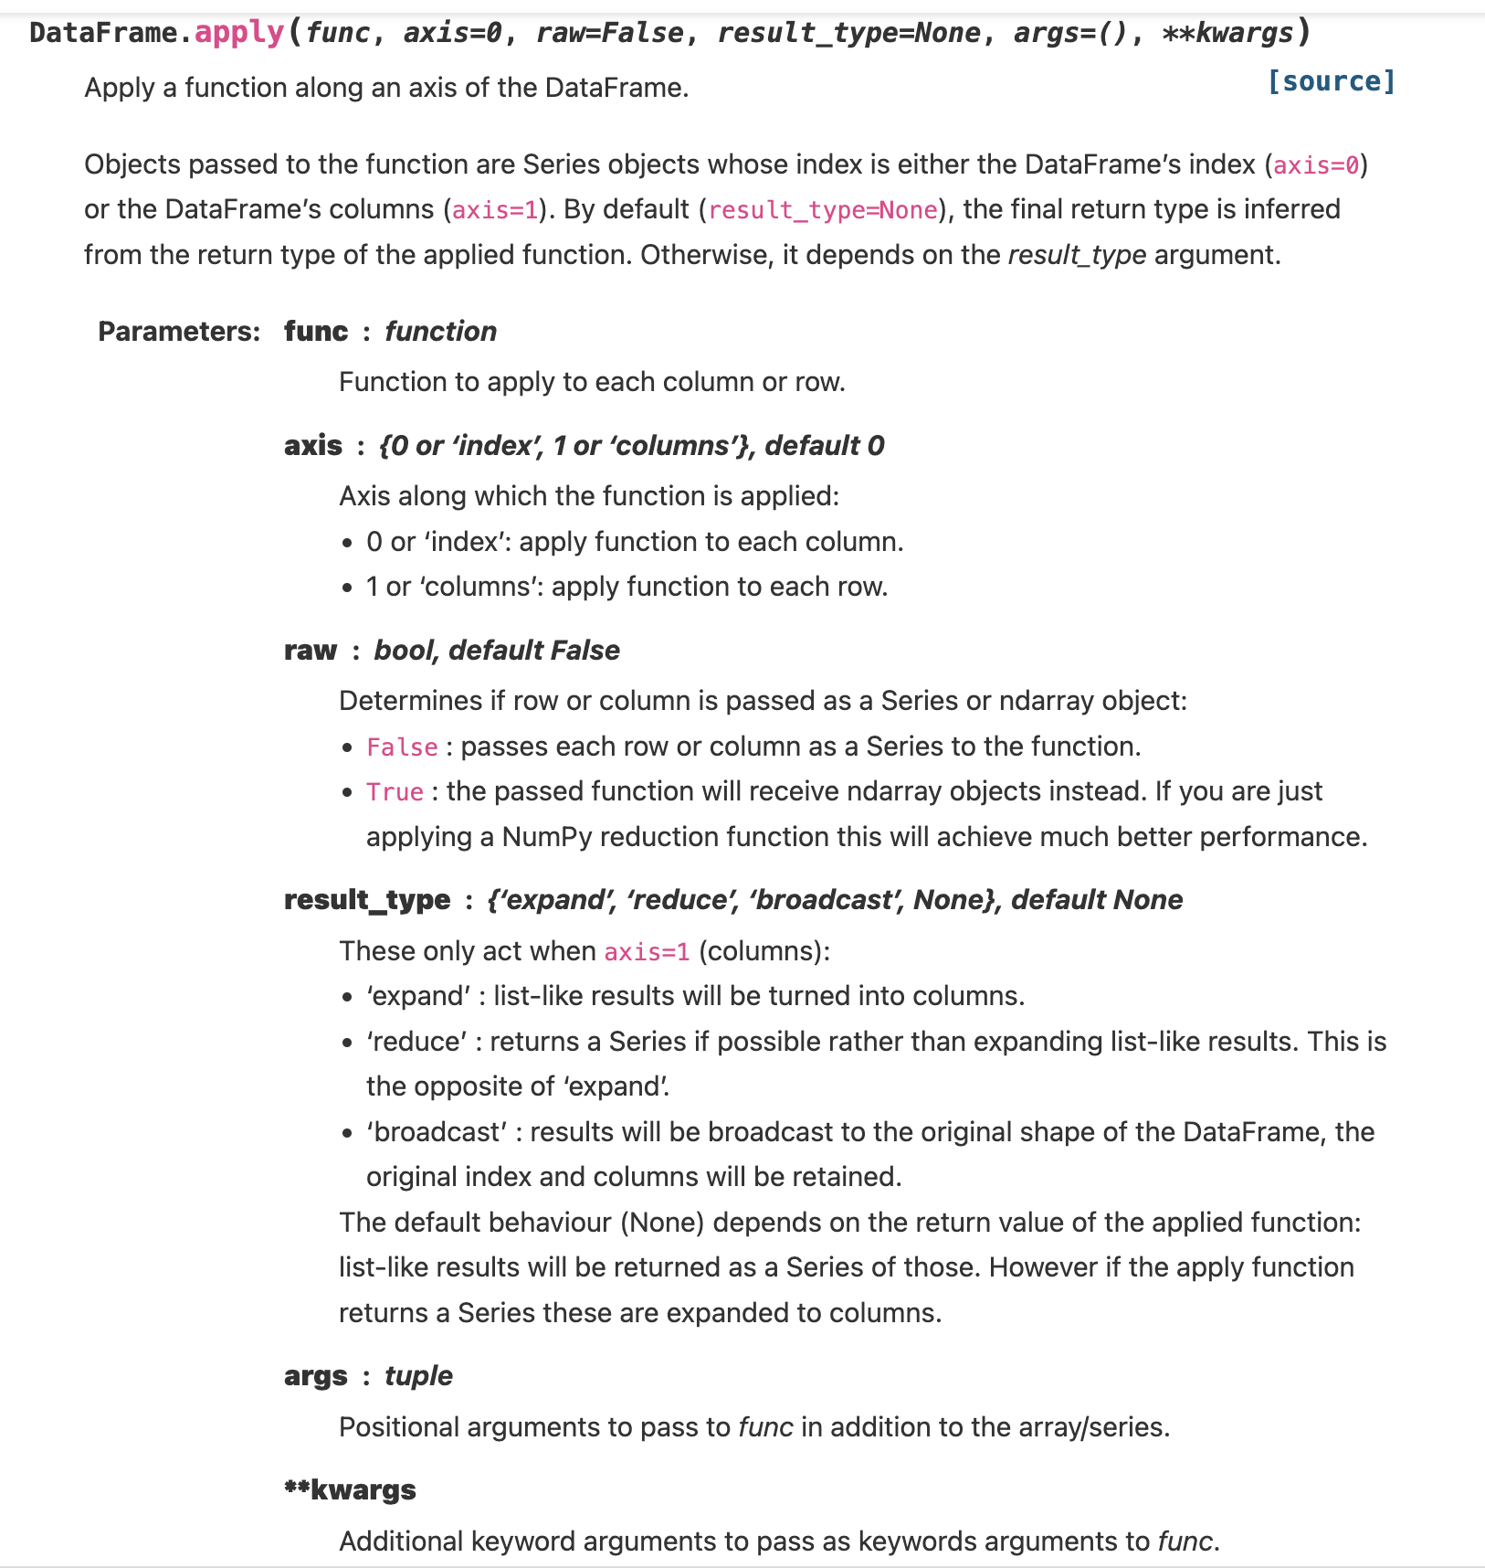
Pandas Apply

Slide 11
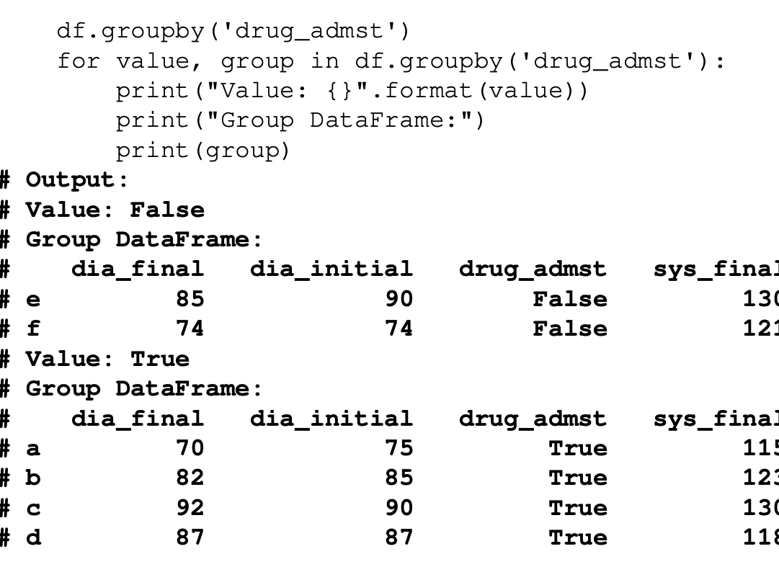
groupby
patients = ["a", "b", "c", "d", "e", "f"]
columns = {
"sys_initial": [120, 126, 130, 115, 150, 117],
"dia_initial": [75, 85, 90, 87, 90, 74],
"sys_final": [115, 123, 130, 118, 130, 121],
"dia_final": [70, 82, 92, 87, 85, 74],
"drug_admst": [True, True, True, True, False, False]
}
df = pd.DataFrame(columns, index=patients)

Slide 12
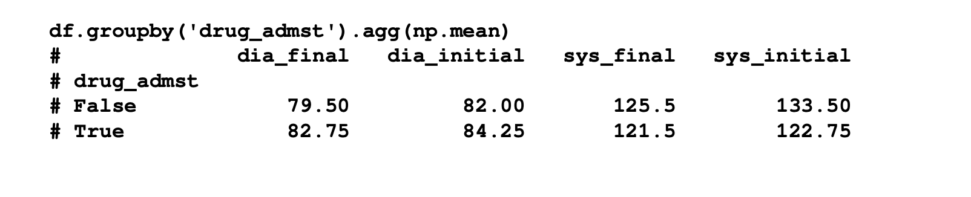
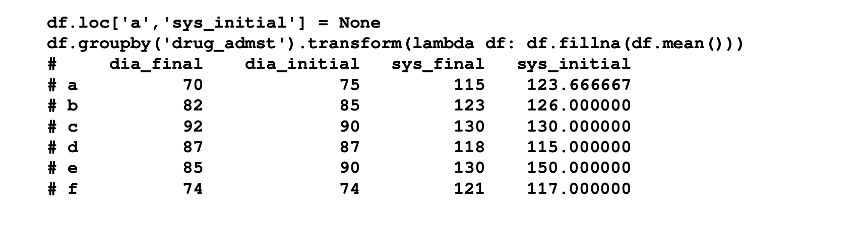
aggregation & transform

Slide 13
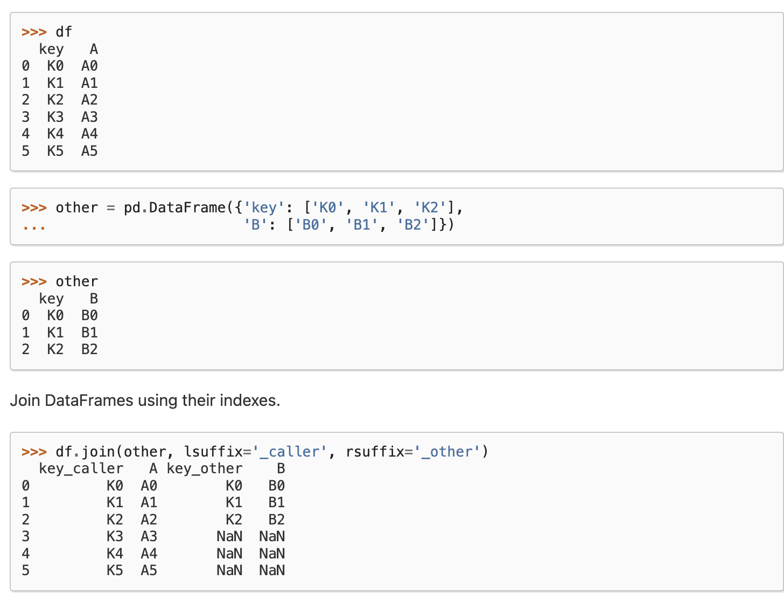
Pandas join

Slide 14
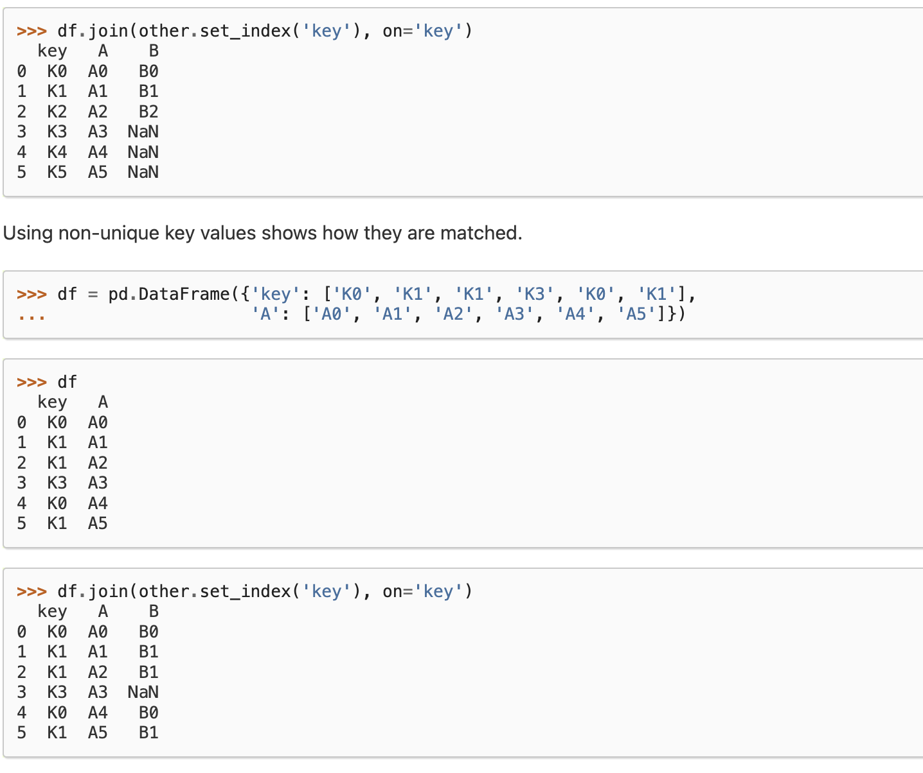
Pandas join

Slide 15
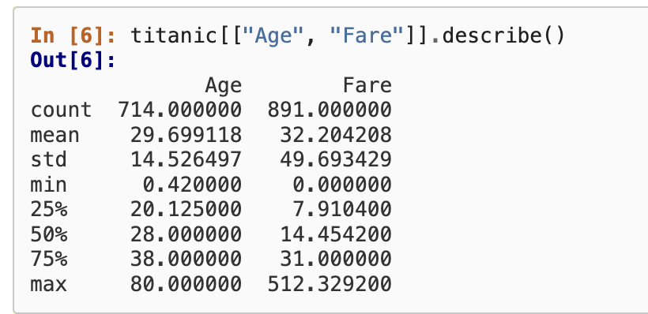
Pandas describe

Slide 16
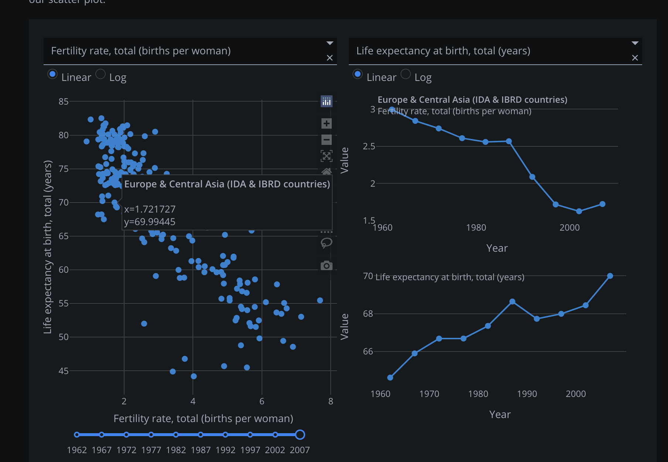
Dash

Slide 17
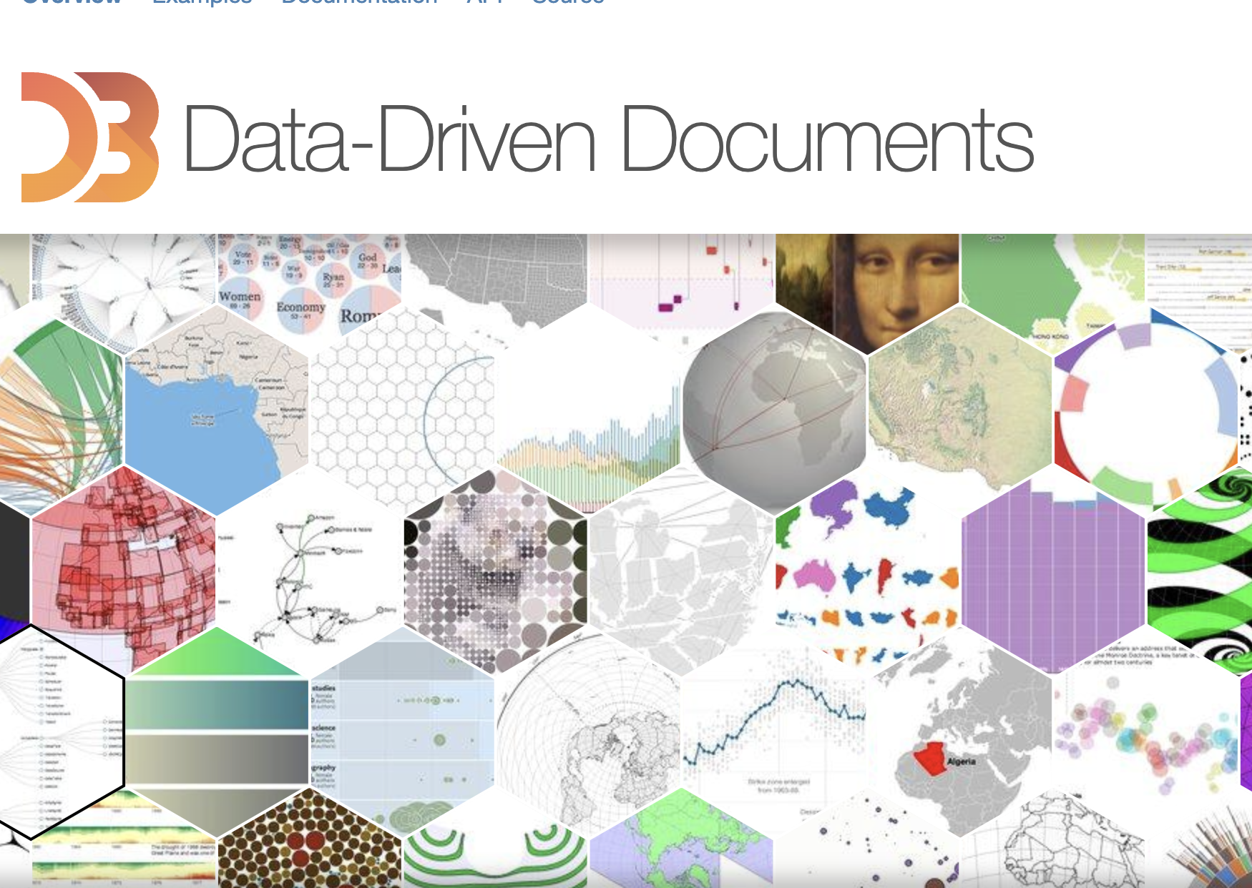
D3.js

Slide 18
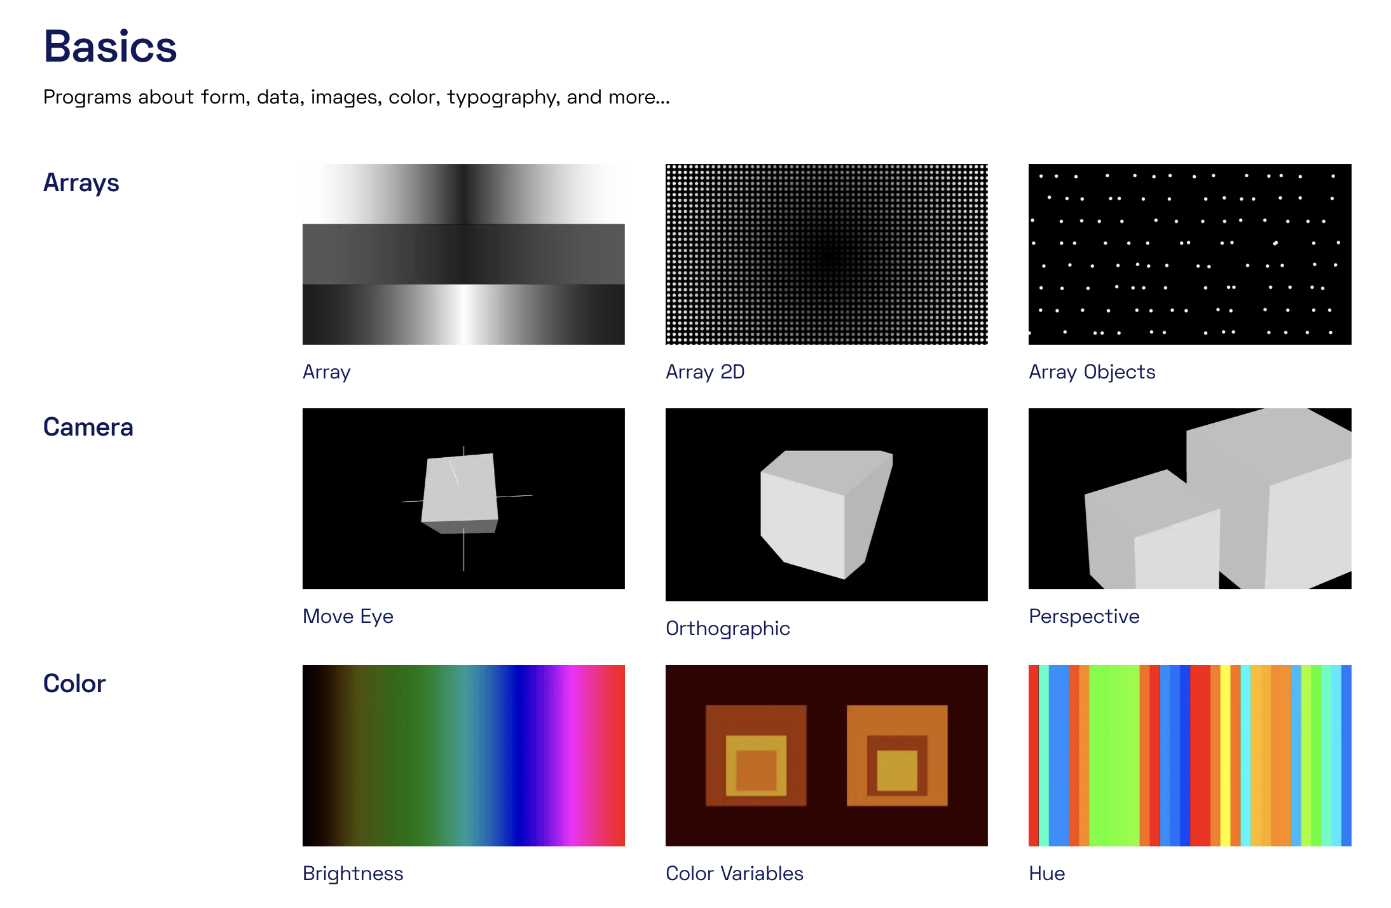
Py-processing

Slide 19
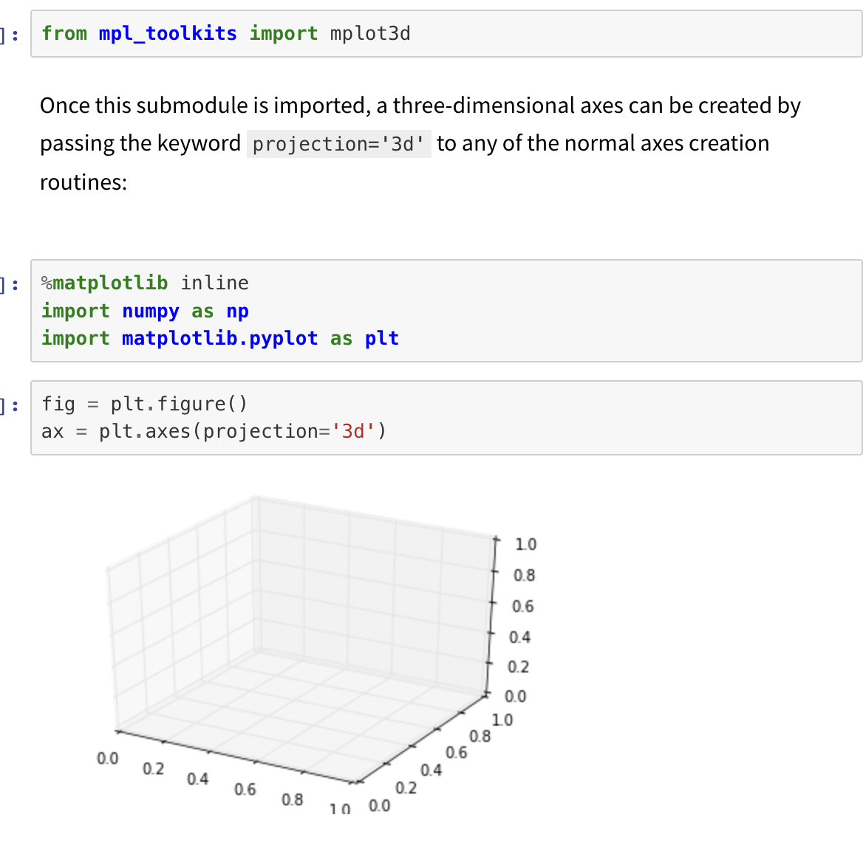
Matplotlib – 3d

Slide 20
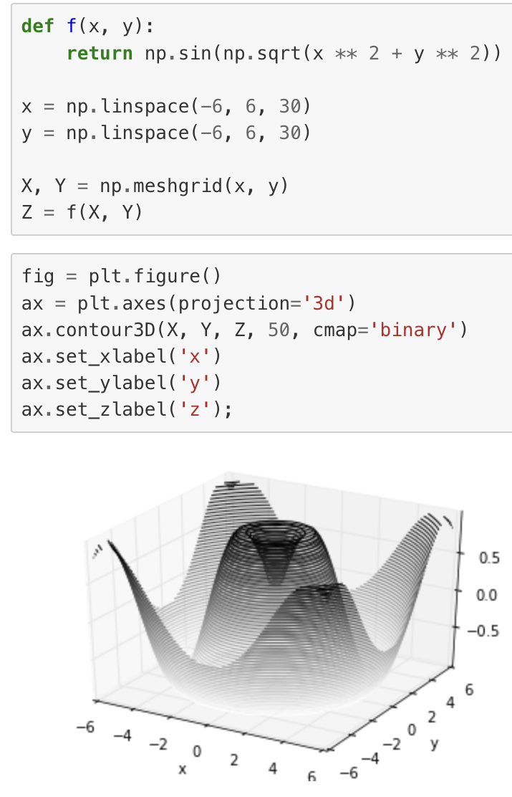
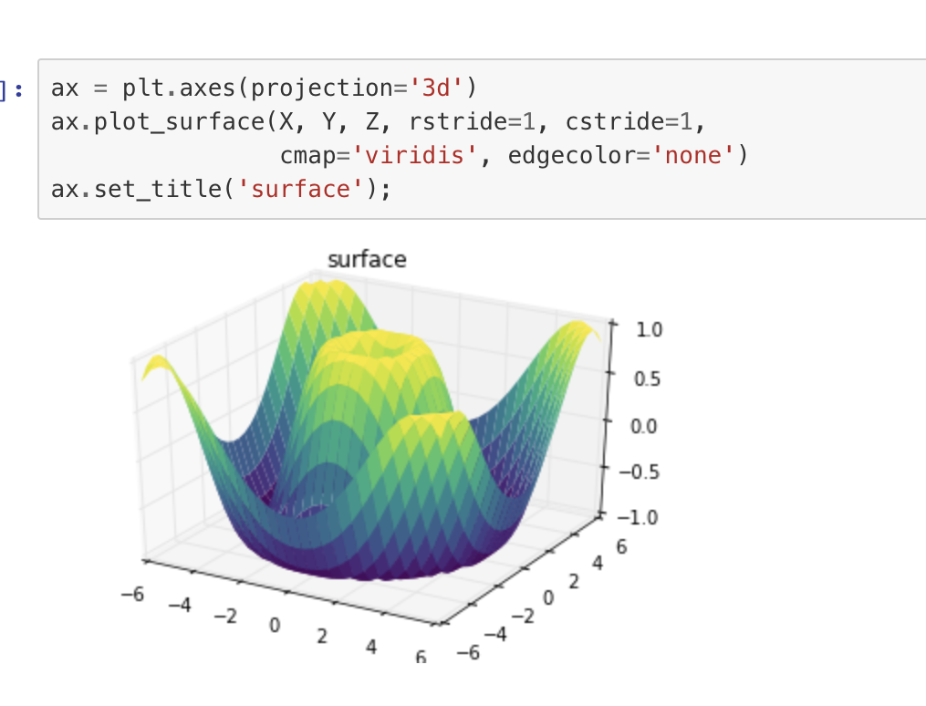
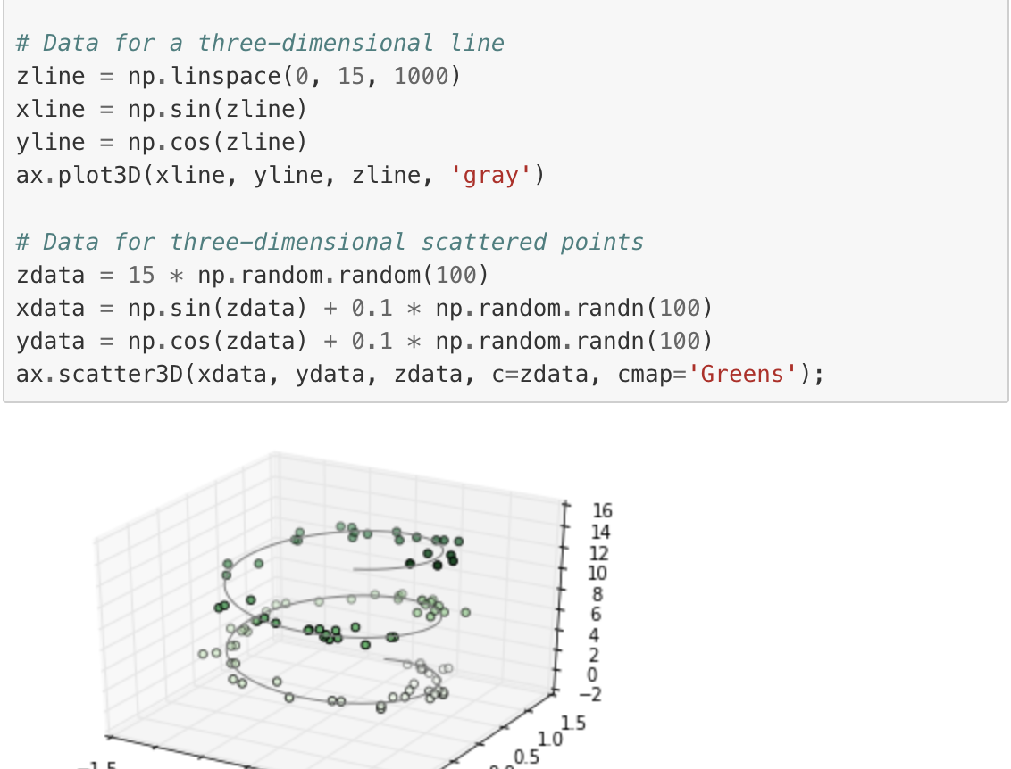
Matplotlib – 3d

Slide 21
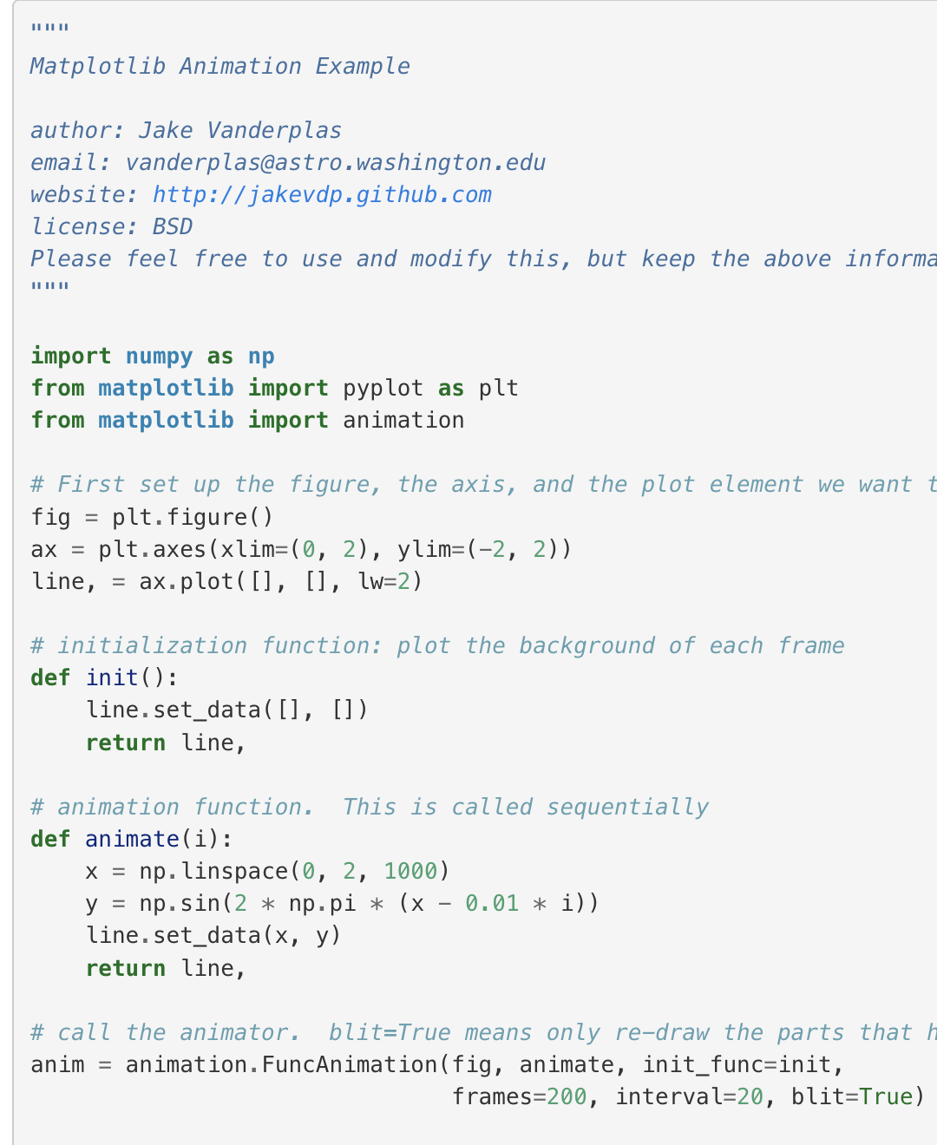
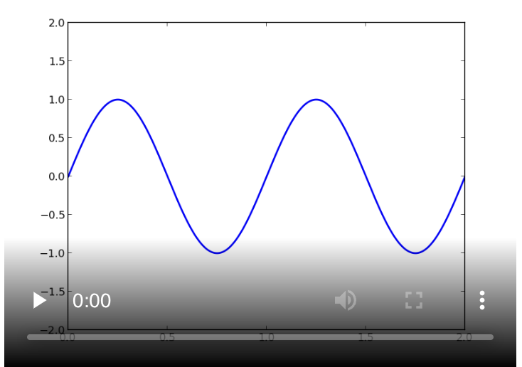
Matplotlib - animate

Slide 22
Matplotlib - animate
def draw_a_random_curve():
i = random.choice(range(len(sub_x)))
linear_output = np.concatenate((random_linear(sub_x[:i]), random_linear(sub_x[i:])))
i2 = random.choice(range(len(linear_output)))
output = np.concatenate((random_linear(sigmoid(linear_output[:i2])), random_linear(sigmoid(linear_output[i2:]))))
return output
def draw(index):
fig.clear()
plt.plot(sub_x, draw_a_random_curve(), color='green')
plt.plot(sub_x, draw_a_random_curve(), color='red')
fig = plt.gcf()
FuncAnimation(fig, draw, interval=500)

Slide 23
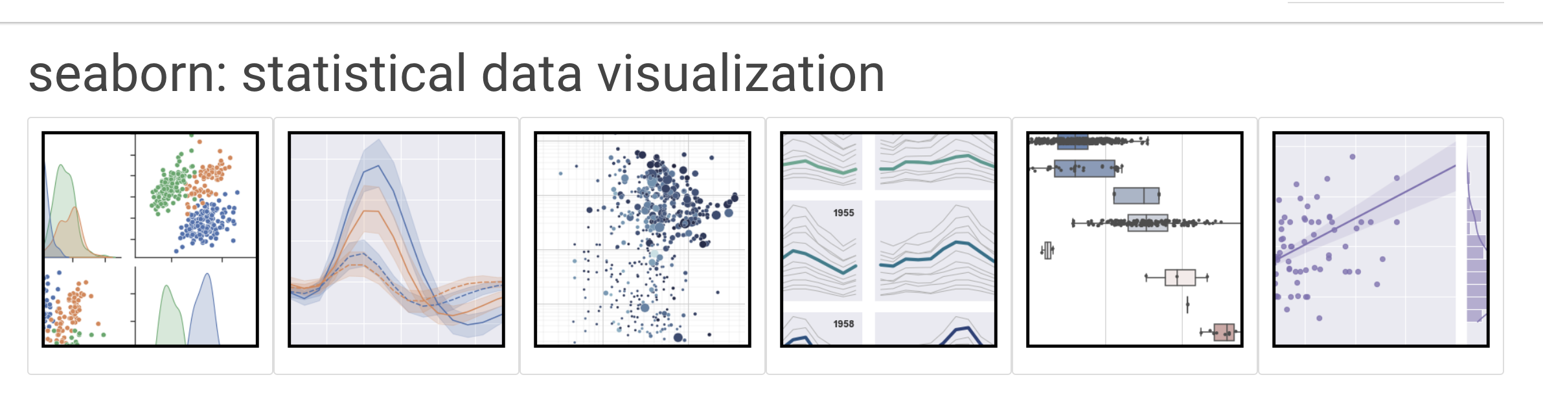
seaborn

Slide 24
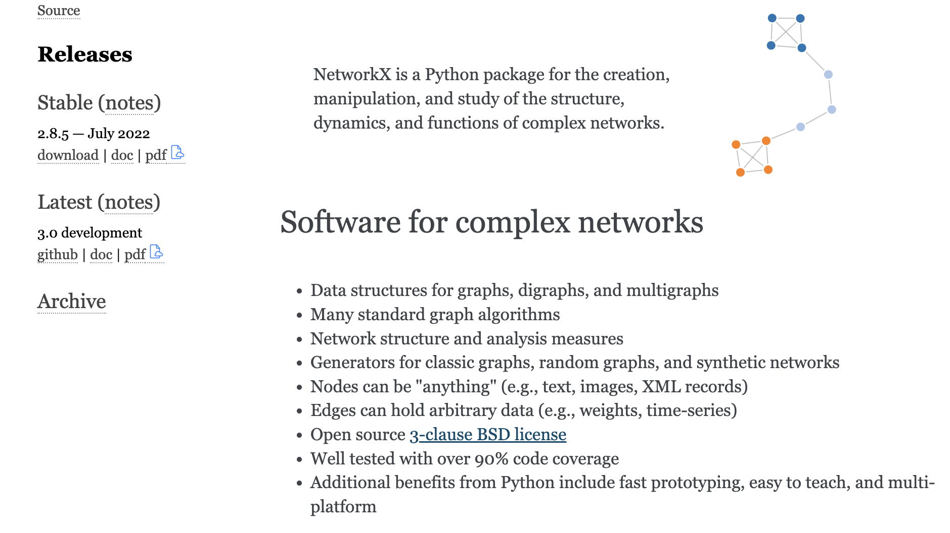
netowrkx

Slide 25
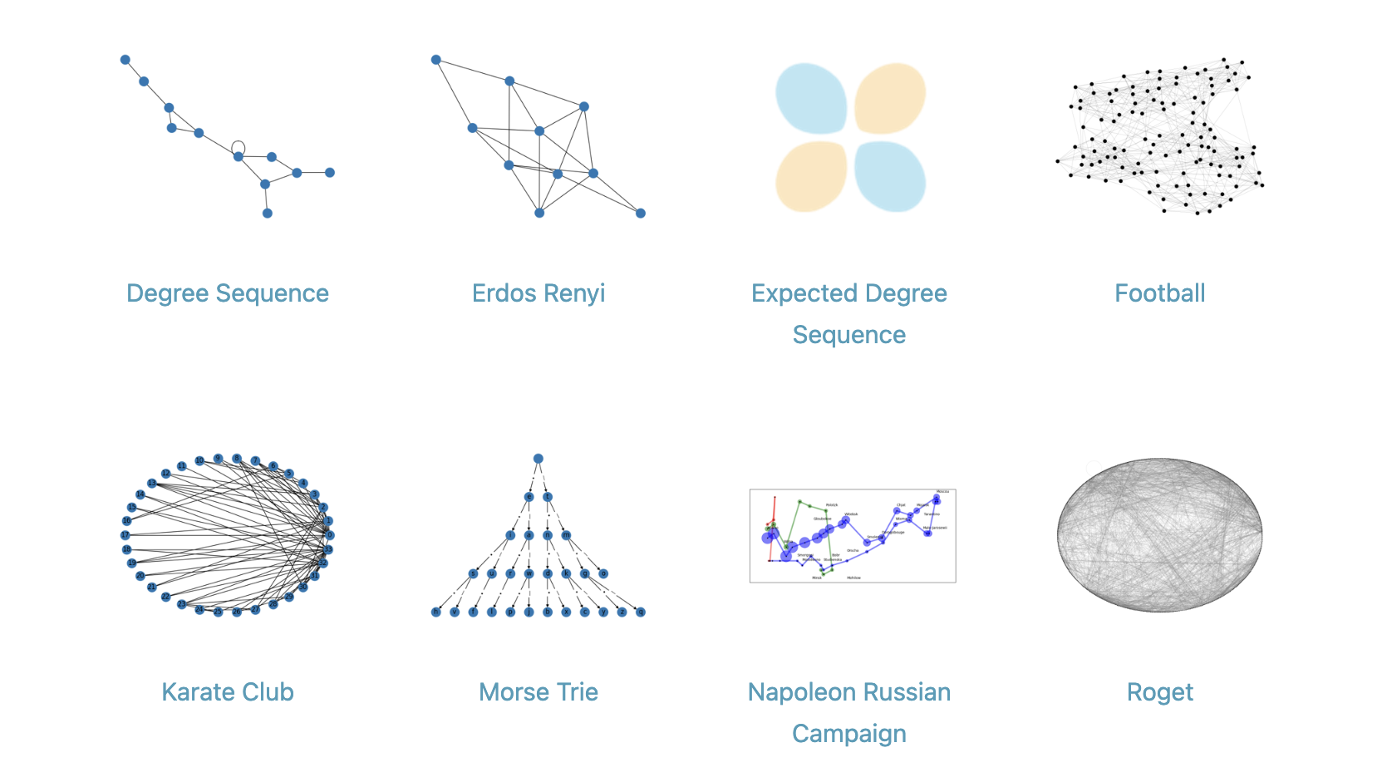
netowrkx

Slide 26
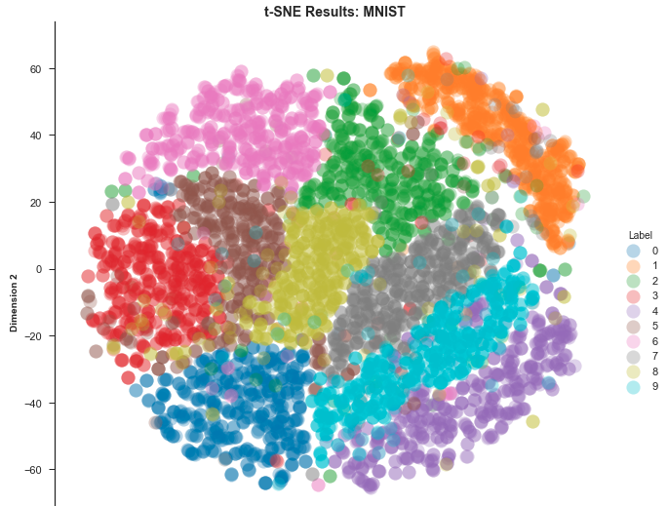
tsne

